Slide 1
Mid Term Presentation
Uplift Model For Customer
Propensity Modeling
by
Sai Raghu Teja Davuluri
170907024
Under the guidance of
Internal Guide External Guide
Dr. Goutham Simha GD Mr. AAKASH SHARMA
Assistant Professor Sr. Manager
Department of ECE AS Dept
Manipal Institute of Technology Ugam Solutions Pvt. Ltd.

Slide 2
Contents
About the company
Problem Statement
Introduction
Software Requirements
Implementation
Data Summary
Work done till date
Remaining work
References

Slide 3
About the Company
Ugam Solutions Pvt. Ltd.
Ugam is a leading analytics and technology services company.
Over the past 20 years, Ugam has been recognized by several firms including Forrester and Gartner and was recently named the No.1 data science company in India by Analytics Insight.

Slide 4
Problem Statement
Develop a predictive model to identify the individuals who are only likely to respond after receiving a particular ‘treatment’ you decided to give them using Uplift.
Know
Prepare
Prepare market response models.
Create
Create a model to identify the individuals who are only likely to respond after receiving a particular ‘treatment’ you decided to give them.
Know your metrics & segregate the customers according to that.

Slide 5
Introduction
Uplift modeling uses a randomized scientific control to not only measure the effectiveness of a marketing action but also to build a predictive model that predicts the incremental response to the marketing action
This project deals with knowing the metrics on which the customers will be segmented and predictions

Slide 6
Software Requirements
Language: Python 3.6
IDE: Jupyter Notebook
Libraries to be used: pandas, numpy, pylift, matplotlib, sklearn, seaborn

Slide 7
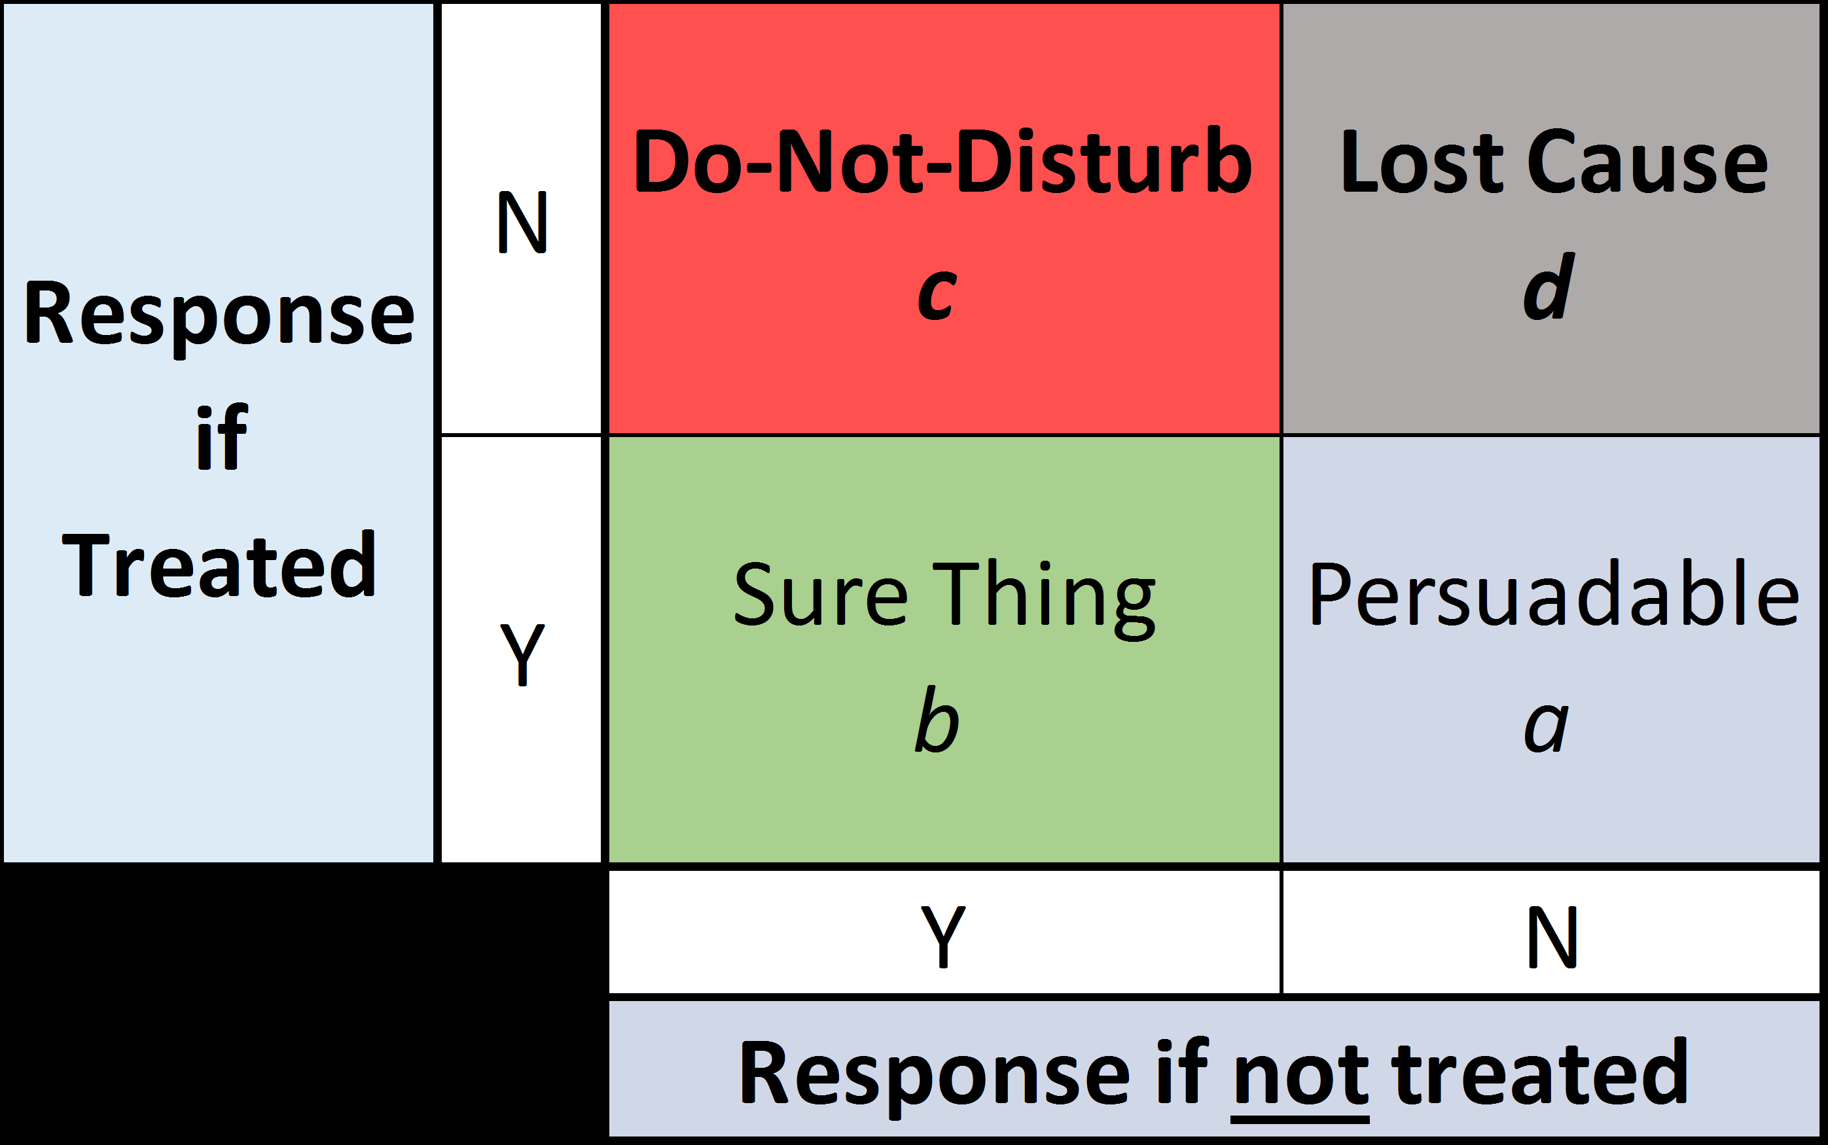
Implementation
The problem can be approached in four different method:
Traditional Approach
Two Models Approach
Single Model Approach
Data is divided into two sets Control group and Treatment group
The objective of Uplift modeling is to identify the Persuadables and target them in promotion.

Slide 8
Data Summary
We have used Uplift Modelling.xlsx ,sheet=1 for the analysis.
Total 5000 records/observations
19 variables of mixed datatypes
11 categorical variables and 8 continuous variables
Train and Test Split: All the mutations of data are divided into Train and Test data sets in the ratio of 80:20.

Slide 9
Data Summary
treatment | HO= Control Group Promo = Test Group
zip5 | zip code
unique_key | unique identifier of the record
age | age of the customer
channel | DM = Direct Mail DM_EM= Direct Mail & Email
state | state
inq_month | months since the last inquiry was made by customer
resp | did the customer respond
conv | did the customer convert
region | region
division | division
cancel_reason_bucket | Policy cancelation reason
annual_premium_select | annual premium on the policy
driver_cnt_select | driver count in a household
vehicle_cnt_select | vehicle count in a household
polk_flag | presence of auto in a household
pif_own_rent_cd | O - homeowner R- Renter T - Refused information blank - no information available
internet_sale_ind | Policy purchased through Internet
pif_risk_lvl | risk level of customer B - preferred C - Non Preferred D - Reject
 | Blank - N/A

Slide 10
Work Done till now
Understanding all the metrics in the dataset provided by the client
Pre-processing
Filtering/Imputing out the invalid entries
Label Encoding
Traditional algorithm has been modelled
Two- Model Approach has no good performance

Slide 11
Work Done till now
Traditional Approach:
Goal : To separate those who are likely to respond vs those who are less likely to respond to a promotion.
A,C and F,G are the Sure Thing! B,H are the Persuadables.
Approach:
1. Mark A/B/C as 1 and the rest (D to J) as 0. Up-sample the training data.
2. Train the model on the entire dataset. If the model identify 1 then send promo, if 0 we do not send promo
Reason why it works:
- With the old response model, normally we will build it based on all responders (A,B, C, F, G), which means B is only 20% of the responders. With the new approach, we only identify A, B, C as responders, now B accounts for 33% of the responders, meaning that the model is more likely to capture B&H in the validation dataset.
 | Audience
Treat | A | B | C | D | E
Control | F | G | H | I | J
* Highlight in green means that the customer responded

Slide 12
Work Done till now
Column1 | train_accuracy | test_accuracy | train recall | test recall | train auc | test auc
RF basic | 93.2 | 83.4 | 64.8 | 21.8 | 82.1 | 60.2
RF_fea_eng | 100 | 83.2 | 100 | 26.43 | 100 | 61.8
RF_up | 100 | 82.53 | 100 | 17.24 | 100 | 57.91
XG_basic | 93.75 | 83.44 | 61 | 29 | 80.37 | 62.81
XG_fea_eng | 93.19 | 84.8 | 61 | 34 | 78.66 | 65.83
XG_fea_up | 91.21 | 80.72 | 90.9 | 51.11 | 91.21 | 70.22
LR_basic | 88.43 | 83.44 | 39.27 | 25.28 | 68.35 | 61.51
LR_fea_eng | 88.03 | 24.2 | 34.36 | 100 | 50.706 | 66.11
LR_fea_up | 77.29 | 26.1 | 78.5 | 100 | 77.27 | 50.56

Slide 13
Work Done till now
TWO- Model approach
Goal : To identify those that are more likely to respond to a promo by subtracting the scores out of 2 models.
Again, A,C and F,G are the Sure Thing!, B,H are the Persuadables.
Approach:
Train a model on treated group (Model #1) and another on control group (Model # 2).
Apply both Model #1 and Model # 2 on the same person in validation dataset.
Lift = score of model #1 – score of model #2.
The Persuadables are the ones with higher lift ( bigger difference in the score).
Reason why it works:
Given that B is considered a responder in Model # 1, a customer with similar attributes will receive a higher score in Model # 1. On the other hand, H is considered a non-responder in Model # 2, a customer with similar attributes will receive a lower score in Model # 2.
The lift of a customer similar to B will be higher than the lift of a customer similar to A, C that receive high score in both models.
 | Audience
Treat | A | B | C | D | E
Control | F | G | H | I | J
* Highlight in green means that the customer responded

Slide 14
Develop Single Model Approach
Draw Business insights and feature Importance on real world
Improve Performance of Two Model Approach

Slide 15
References
https://medium.datadriveninvestor.com/simple-machine-learning-techniques-to-improve-your-marketing-strategy-demystifying-uplift-models-dc4fb3f927a2
https://www.researchgate.net/publication/270217235_Identifying_Individuals_Who_Are_Truly_Impacted_by_Treatment_Introduction_to_Recent_Advances_in_Uplift_Modeling
https://towardsdatascience.com/tagged/data-driven-growth
https://www.investopedia.com/terms/d/datamining.asp#:~:text=Data%20mining%20is%20a%20process,increase%20sales%20and%20decrease%20costs.
http://www.predictiveanalyticsworld.com/machinelearningtimes/uplift-modeling-making-predictive-models-actionable/8578/
https://www.fingent.com/blog/data-mining-and-predictive-analytics-know-the-difference/
https://www.diva-portal.org/smash/get/diva2:1386196/FULLTEXT01.pdf

